Slide 1
How To Write Unit Tests
Jason Sylvestre
College of Agricultural & Environmental Sciences
April 15, 2011
Notes:
This template can be used as a starter file for presenting training materials in a group setting.
Sections
Right-click on a slide to add sections. Sections can help to organize your slides or facilitate collaboration between multiple authors.
Notes
Use the Notes section for delivery notes or to provide additional details for the audience. View these notes in Presentation View during your presentation.
Keep in mind the font size (important for accessibility, visibility, videotaping, and online production)
Coordinated colors
Pay particular attention to the graphs, charts, and text boxes.
Consider that attendees will print in black and white or grayscale. Run a test print to make sure your colors work when printed in pure black and white and grayscale.
Graphics, tables, and graphs
Keep it simple: If possible, use consistent, non-distracting styles and colors.
Label all graphs and tables.

Slide 2
Writing Unit Tests Using UCDArch
1
2
Types Of Unit Tests
4
Helper Methods and Abstract Base Classes
Structure Of Unit Tests
5
Resharper Templates
3
File Structure Of Unit Tests
Notes:
Our tests are tightly bound to UCDArch
1) basically how to format the tests
2) the different types of tests (repository, controller, etc.)
3) the different folders within the test project and where code and tests are located
4) Some of the helpers and abstract base classes we use
5) Resharper templates that aid in creating tests

Slide 3
Structure Of Unit Tests
Notes:
Arrange, Act, and Assert

Slide 4
Structure Of Unit Tests
Arrange
Setup data specific to that test
Call Methods to setup common values
Mock and Fake
Act
Assert
Check for expected values
Check that specific mocked methods were called
Get and check parameters passed to mocked methods
Inconclusive check. Fails locally, but not on the builder.
Notes:
Arrange: Part of the setup is done in the base class
Act: Where the method is called (The controller method, or ensure persistence, remove, etc.)
Assert: True unit tests have only one assert per unit test, but I find that too restrictive. Even the Unit Tests generated for the Account Controller in MVC3 assert more than 1 thing per test.
I recommend that each of these sections be wrapped with a region identifying it.
If you use the resharper test runner, you can go to the exact assert that failed.
If an Assert is not clear, it is a good idea to provide a message when the test fails. This is just a parameter.

Slide 5
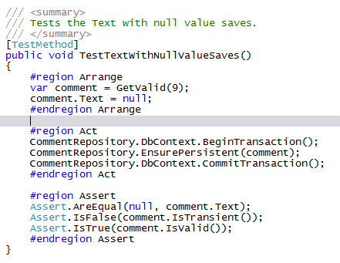
Sample of a simple unit test
Notes:
Repository test where a null value is allowed for a string
GetValid calls CreateValidEntity and then sets any related entities

Slide 6
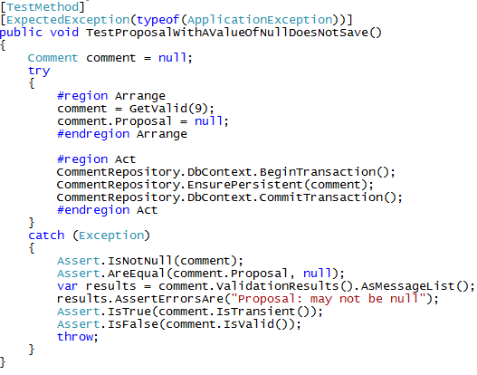
Sample of an Expected Exception
Notes:
We want an exception.
We don’t want a different exception to be triggered. Another way to do this is to set a bool outside the try-catch to false, set it to true just before we expect the exception, then assert in the catch that it is true
Proposal is a related table that has the [NotNull] attribute

Slide 7
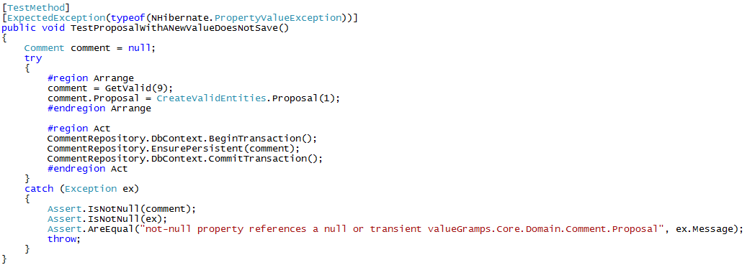
Another Expected Exception
Notes:
Here the proposal is not null, but it isn’t saved and we don’t have the cascade set in the mapping

Slide 8
Types Of Unit Tests

Slide 9
Types Of Unit Tests
Repository Tests
Controller Tests
Interface Tests
Notes:
3 main types of tests.

Slide 10
Repository Tests
Test Database actions
Done on an in memory SQL Lite database created from the mapping file.
This is done by using UCDArch’s base class in testing “: FluentRepositoryTestBase<TMap> where T : DomainObjectWithTypedId<IdT> ”
Notes:
Creating the database and all that magic is done by using UCDarch’s base class.
There is also a base class that doesn’t use the fluent mapping, but we are moving away from that way of mapping

Slide 11
Types of Repository Tests
CRUD Tests (if you use my base class and Resharper template, these are done with minimal coding)
Invalid Boundary Tests
Too Long, Too Short
Not Null
Required
Exceptions
Notes:
The mapping file can indicate if a table is read only, or not mutable. These can be checked with the CRUD tests.
If you use my base class and it fails this is usually because there is a related record that needs to be set in the GetValid method.
Invalid Boundary tests are all the flavors, one over the max, one under the minimum, spaces only, etc.

Slide 12
Types of Repository Tests Cont.
Valid Boundary Tests
Maximum and minimum length
Null, empty, or spaces only when allowed
Constructor Tests
Fluent Mapping Tests
Reflection Tests
Ensure code coverage of tests
Notes:
Valid Boundary tests are the the maximum, minimum, etc.
Constructor tests – just make sure that the expected values are set (for example if you had several parameters, you may accidentally assign the parameter to a different field.
Fluent Mapping tests. I’ll show an example in a bit
Reflection Tests. I use to check for attributes, and to ensure I write tests for each field

Slide 13
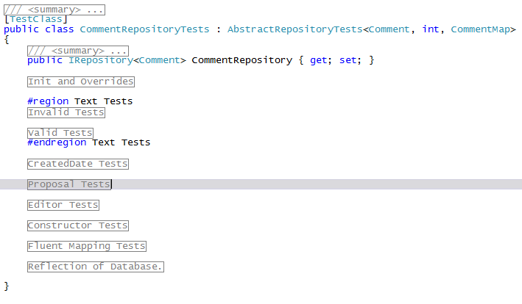
Example of Repository Test layout
Notes:
I prefer to group the different section in Regions, and because I tend to have a lot of regions, I have the descriptive text at the start and end of the region.
There will always be an Init and Reflection regions when you create this with my Resharper template. Then I have each field in it’s own region. I also prefer to group the invalid and valid tests seperatly

Slide 14
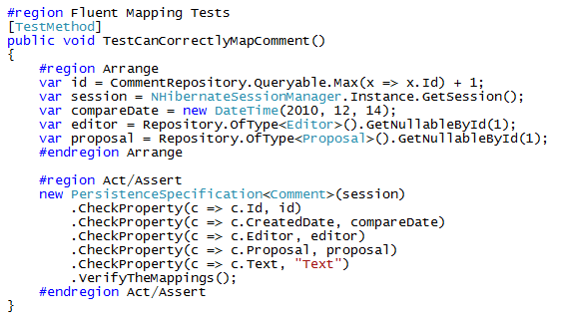
Fluent Mapping Example
Notes:
Fluent mapping is something new I started doing after finding an example on the net.

Slide 15
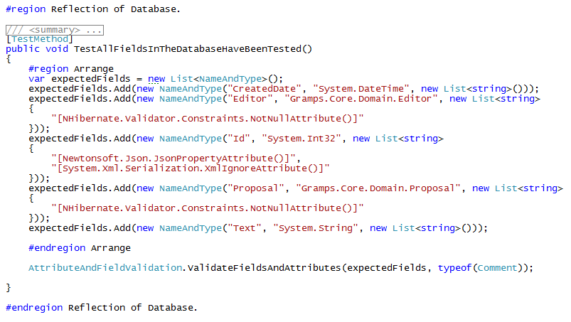
Reflection of the Database Example
Notes:
These tests both check that the attributes are as expected and that the public methods have not been added or removed.
NameAndType and AttributeAndFieldValidation are helper classes I created. This is order, dependent. Sometimes, the attributes get sorted differently on builder vs. your local test runner. If this happens I do have a way to solve it.

Slide 16
Controller Tests
Mapping Tests
Boundary Tests of all public methods
Reflection Tests
Notes:
I have a resharper template that sets up the initial stucture of these tests and also provides some examples
If all these tests suddenly fail, or fail when you first set them up, it is probably because there is Controller injection that needs to be mocked

Slide 17
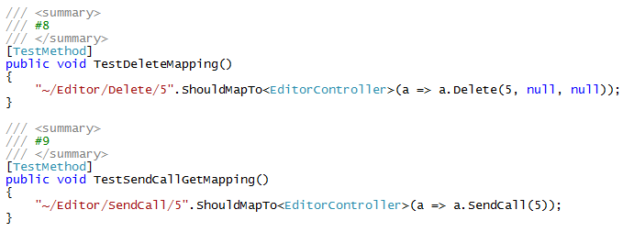
Mapping Tests
Notes:
If the only parameter is the id, these tests work fine. If you have QueryString parameters, I have an overload in the helpers that can ignore the parameters.

Slide 18
Boundary Tests of all public methods
Sorry, no auto generated tests (But I do have helpers)
Setup the data (Fake)
Mock methods
Repository, Interfaced methods
Assert that they were or were not called
Check that the parameters passed were what was expected
Check that a view was rendered or was redirected
Check Controller Message and ModelState
Notes:
The helpers are the ones to fake data (base class in UCDArch.Testing)
Doing boundary tests for controller methods gets uglier as the complexity of the method increases. Using interface methods reduces some of this complexity. Avoid static methods as much as possible as they can’t be mocked (not easily)
Any repository mocking is usually done in the class initialization.
Basically, any parameters passed to the controller’s class (injection) has to be mocked in the test init.
If Possible create a method to fake all the data you will need for all your tests, it really cleans up the arrange part of the tests.
If the controller is checking the CurrentUser’s identity this needs to be mocked. There is a methed in UCDArch.Testing to mock this as well as any files that may be returned.
Usually we test what is returned (redirect/view), error messages, and that expected code is executed.

Slide 19
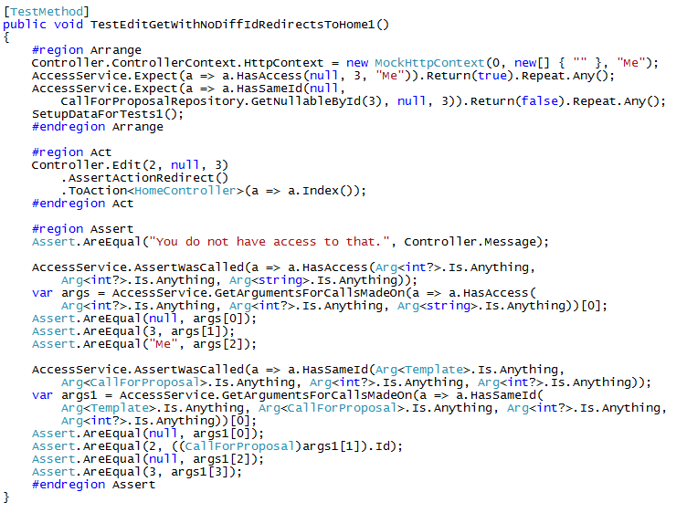
Example Of A Controller Method Test
Notes:
Uck, I know. It can be worse which makes the test even more fragile.
HasSameId is mocked to return false, if HasAccess was mocked to return false, it would return the same way, but the “AssertWasCalled” for HasSameId would not have been reached.

Slide 20
Reflection Tests
Tests existence of attributes which are not called in the unit tests
Uses reflection
Ensures code coverage
I only add the method to this section once I have done Mapping and Boundary Tests
Two Main Areas
Controller Class
Controller Methods
Notes:
Controller Attributes are never run from unit tests, Reflection at least lets us know the attribute is there or not.
Similar to repository tests, I use these for code coverage as I have a count of the public methods.
I check the class attributes, then each method’s attributes too.
This is particularly important for Authorization attributes

Slide 21
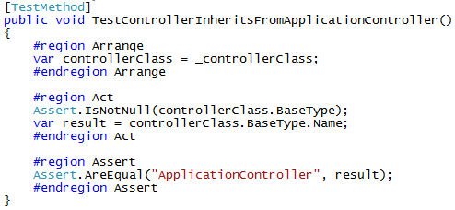
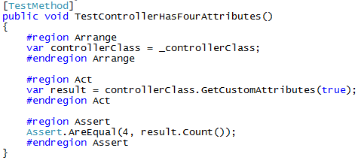
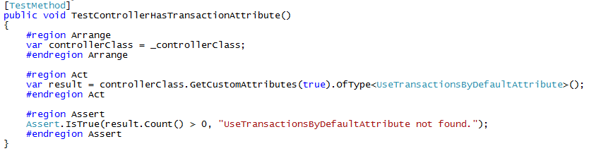
Controller Class Tests
Notes:
For each of the 4 attributes found, I would have a test like the bottom one.

Slide 22
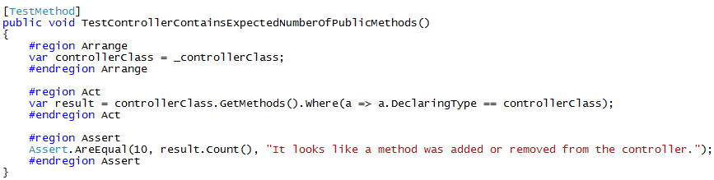
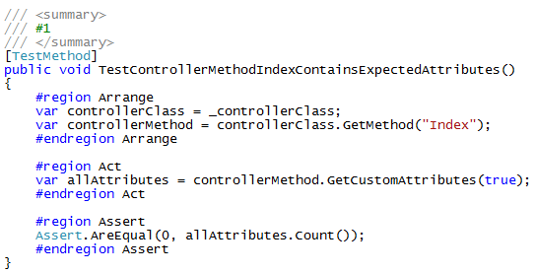
Controller Method Tests
Notes:
If you are working on a controller, you may not want the builder to keep showing up errors, you could add an Assert.Inconclusive(“some message”) You will get that the test failed, but not builder.
I like to have a number in the summary for these tests, and the mapping tests, that matches up to a number in the summary of the controller method.

Slide 23
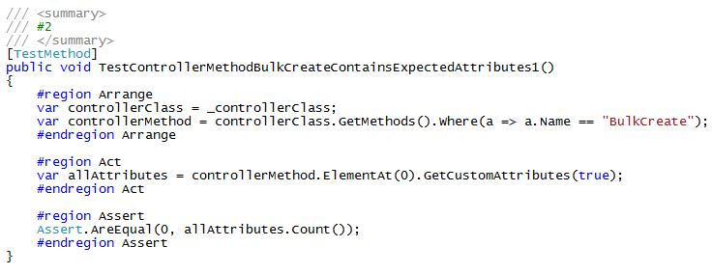
Controller Method Tests Cont.
Notes:
Create has both a Get and Post, so we need to use “ElementAt()” to identify which one we are looking at.

Slide 24
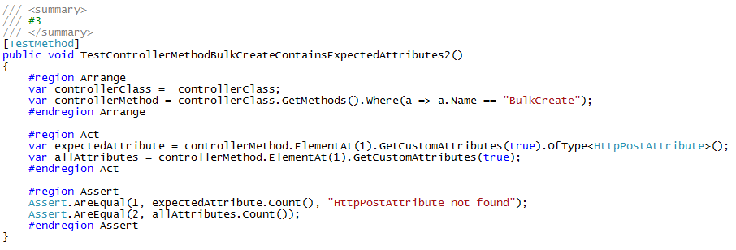
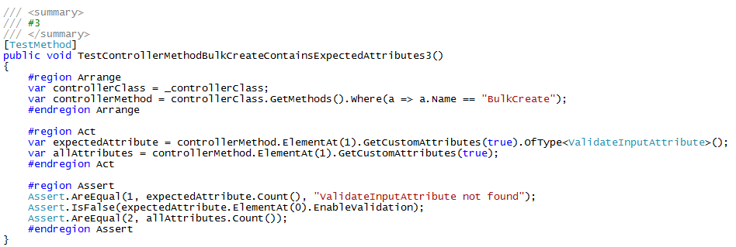
Controller Method Tests Cont.
Notes:
This post method has two attributes.
We can also example values within the attribute

Slide 25
Interface Tests
Sometimes these need to be run within the structure of a Controller test
Check that expected parameters are passed
Check that any actions or return values are what is expected
Even if you don’t write tests for your interfaces, you just have one place to review the logic.
Notes:
If one of your interface methods sends an email, you probably don’t want to test it.

Slide 26
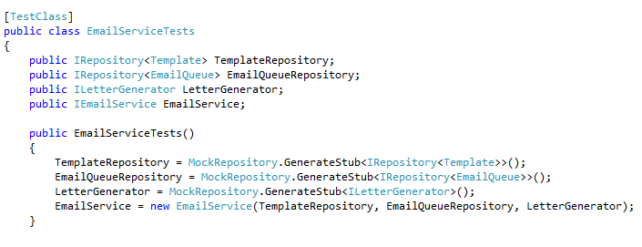
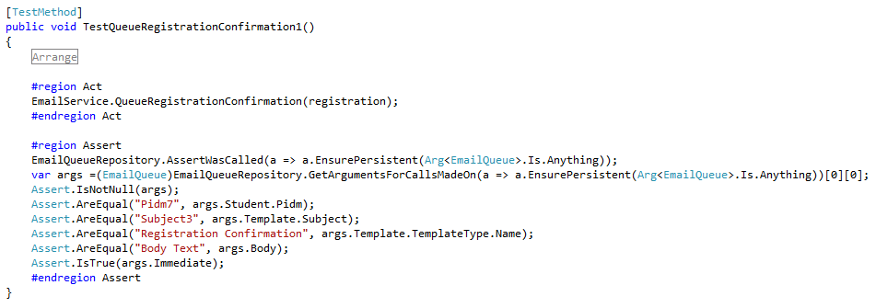
Interface Tests Example

Slide 27
File Structure Of Unit Tests

Slide 28
File Structure Of Unit Tests
Project.Tests
ControllerTests
Core
InterfaceTests
MiscTests
RepositoryTests
ViewModelTests

Slide 29
ControllerTests
Controller1Tests (Partial Classes)
Controller1TestsInit.cs
Controller1TestsMapping.cs
Controller1TestsPart01.cs
Controller1TestsPart02.cs
Controller1TestsReflection.cs
Controller2Tests.cs
Notes:
Controller tests often get very long which causes resharper to slow down. I like to break these into partial classes.

Slide 30
Core
Extensions
AssertExtensions.cs
RouteTestingExtensions.cs
StringExtensions.cs
Helpers
AttributeAndFieldValidation.cs
ControllerRecordFakes.cs
CreateValidEntities.cs
NameAndType.cs
SpecificGuid.cs
AbstractRepositoryTests.cs (until moved to UCDArch)
Notes:
You will probably need to edit CreateValidEntites and ControllerRecordFakes as you write tests.

Slide 31
Interface Tests
<InterfaceName>Tests.cs
Notes:
If you have any.

Slide 32
Misc Tests
Test that Role Attributes work as expected.
Other Tests that don’t really fall in other categories

Slide 33
RepositoryTests
SmallRepository1Tests.cs
LargeRepository2Tests (partial Classes)
LargeRepository2TestsInit.cs
LargeRepository2TestsConstructor.cs
LargeRepository2TestsFluentMapping.cs
LargeRepository2TestsPart01.cs
LargeRepository2TestsPart02.cs
LargeRepository2TestsReflection.cs

Slide 34
ViewModel Tests
I’d suggest only having ViewModel Tests if the logic is particularly convoluted.
These tests can usually be integrated into the controller tests

Slide 35
Helper Methods

Slide 36
Helper Methods
UCDArch.Testing. More may be moved there
ControllerRecordFakes.cs
FakeHttpPostedFileBase.cs
FakeIdentityAndFiles.cs
AttributeAndFieldValidation.cs
CreateValidEntities.cs
NameAndType.cs
SpecificGuid.cs
Notes:
ControllerRecordFakes is an abstract base class that makes it a lot easier to fake data for Controller tests. It fakes, GetNullableById, Queryable, and GetAll
CreateValidEntities is where you would create a static method for each of your tables, and populate the required fields. String fields I always populate as The FieldName + counter if the counter is not null. This ties in with my Repository abstract base class methods.
If you have Guid as the Id, SpecificGuid lets you set your test data to reproducible values.

Slide 37
Resharper Templates

Slide 38
Resharper Templates
Generate Files or Code, prompting values to be replaced
My templates start with Jason so I can find them easily. If you use mine, feel free to rename or edit them.
Two main Types of Templates
FileTemplates
LiveTemplates

Slide 39
File Templates
JasonControllerTest
Creates a simple file with examples for Controller tests
JasonRepositoryTest
Creates a repository test file using the Abstract base class
Initializes data, does CRUD tests.

Slide 40
Live Templates
JasonBoolTests
Creates two tests, code for reflection in comment
JasonCheckRequire
Single Test with expected Exception
JasonDateTests
Three Tests, past current, future. No Nullable. Code for Reflection
Evict
Code to evict entity.
JasonGetArguments
Code to get the arguments for Repository Entity EnsurePersistent. Needs tweeking.
JasonStringTests / JasonStringTestsLengthOnly
A bunch of string tests. Needs a little tweeking sometimes. Code for Reflection

Slide 41
Summary
This is the basic structure for Unit Tests that I have been using.
It continues to evolve.
If you come up with other ways to get better coverage, less fragile tests, or other improvements please share.
Notes:
Summarize presentation content by restating the important points from the lessons.
What do you want the audience to remember when they leave your presentation?
Save your presentation to a video for easy distribution (To create a video, click the File tab, and then click Share. Under File Types, click Create a Video.)

Slide 42
Resources
The Art of Unit Testing http://artofunittesting.com/
This slide deck and related resources: https://github.com/jSylvestre/ResharperTemplates

Slide 43
Questions?

